Slide 1

Bank Analytics Dashboard Project
This presentation provides a data-driven overview of banking trends. We'll cover loan analysis, customer insights, and key performance indicators. The goal is to enhance decision-making within the banking sector. These insights will help optimize banking policies.
IT
by Indumathi Thimmareddy

Slide 2




Tools Used
Microsoft Excel
Pivot Tables & Charts
Data Cleaning
Used for data analysis and dashboard creation.
Addressed inconsistencies, errors, and gaps.
Summarized and visualized key datasets.

Slide 3
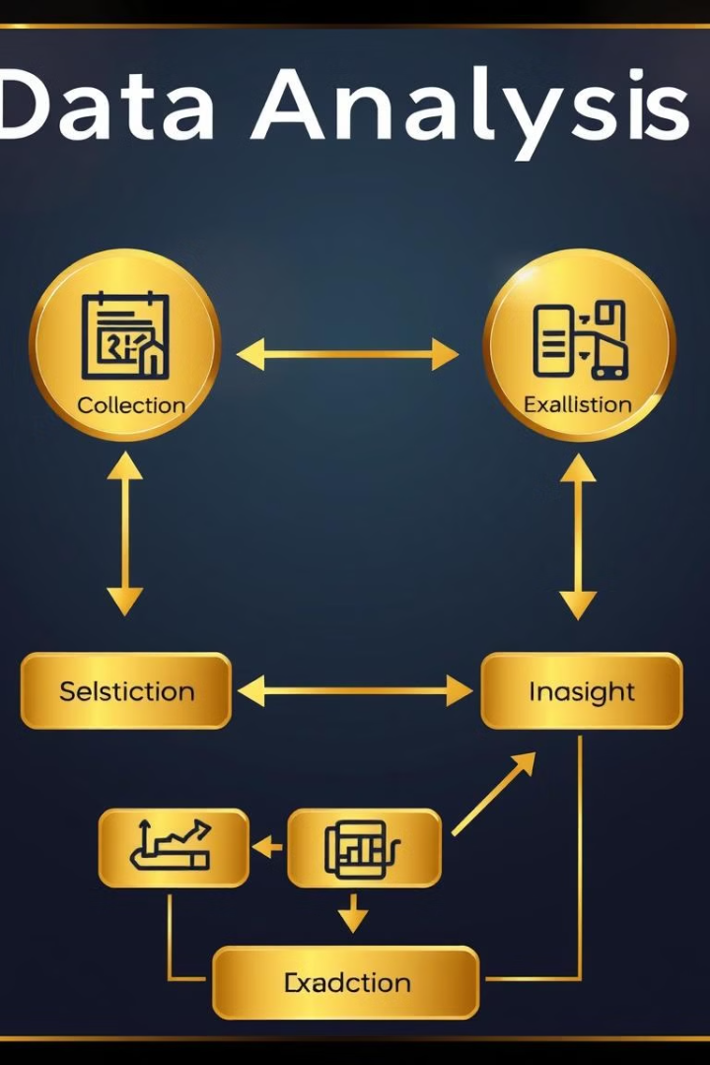




Project Workflow
Data Collection & Cleaning
Dataset imported with loan details. Duplicates removed, values handled.
Create Metrics & Pivot Tables
Summarized total loan, amount, status. Grouped by year.
Dashboard Development
Designed visualizations. Added filters for analysis.
Insights & Recommendations
Analyzed trends and balances. Provided strategies.

Slide 4
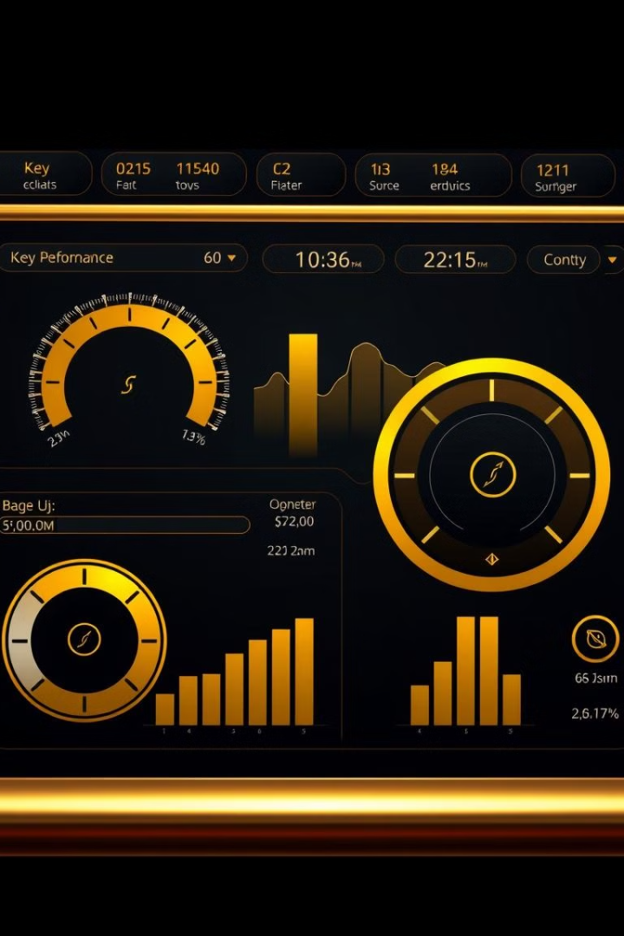
Main KPIs
$446M
Total Loan Amount
Loans issued
$435M
Total Funded Amount
Amount Funded
2012
Top Loan Year
$104M loans issued
59%
Loan Verification Rate
Loans verified

Slide 5
Key Insights & Analysis
Loan Growth Trends
Home Ownership
Verification Rate
Issuance peaked in 2012 ($104M). Shift in policies?
Mortgage holders: highest approvals. Risk factors?
41% loans not verified. Stricter process needed.

Slide 6

Recommendations
1
Improve Verification
Increase verification rates.
2
High-Performing Years
Replicate success factors.
3
Expand Accessibility
New risk assessment.
4
Monitor Balances
Optimize loan ratios.

Slide 7

Conclusion
Actionable Insights
Quick Decisions
Dashboard provides insights.
Excel enables fast decisions.
Refine Policies
Future Scope
Helps optimize funding.
Enhance with Power BI.

Slide 8

Thank You
Thank you for your time and attention. This concludes our presentation on the Bank Analytics Dashboard Project. We welcome your questions and feedback. Further analysis is needed.

